Slide 1
CS 401 – ARTIFICIAL INTELLIGENCE
LECTURE : Local search algorithms

Slide 2
Local search algorithms
Random restart hill climbing (expected number of restarts and steps calculation)
Simulated annealing
Local beam search

Slide 3
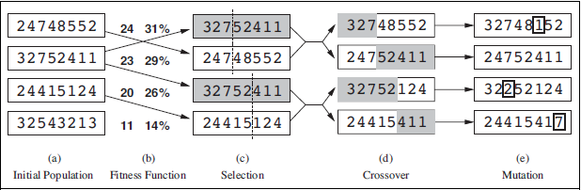
Genetic algorithm

Slide 4
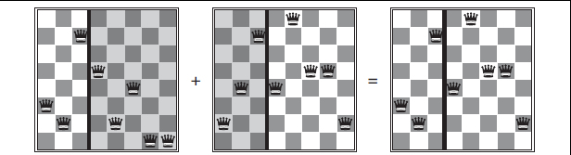
Crossover explained

Slide 5
ITEM | WEIGHT | SURVIVAL POINTS
SLEEPING BAG | 15 | 15
ROPE | 3 | 7
POCKET KNIFE | 2 | 10
TORCH | 5 | 5
BOTTLE | 9 | 8
GLUCOSE | 20 | 17

Slide 6
Choose an initial population of four. Then choose best three subsequently (Encoding hint: 1 if item is chosen 0 otherwise)
Decide crossover point.
Chance of mutation = 50 items in 100 generations.
Step by step solution ahead

Slide 7
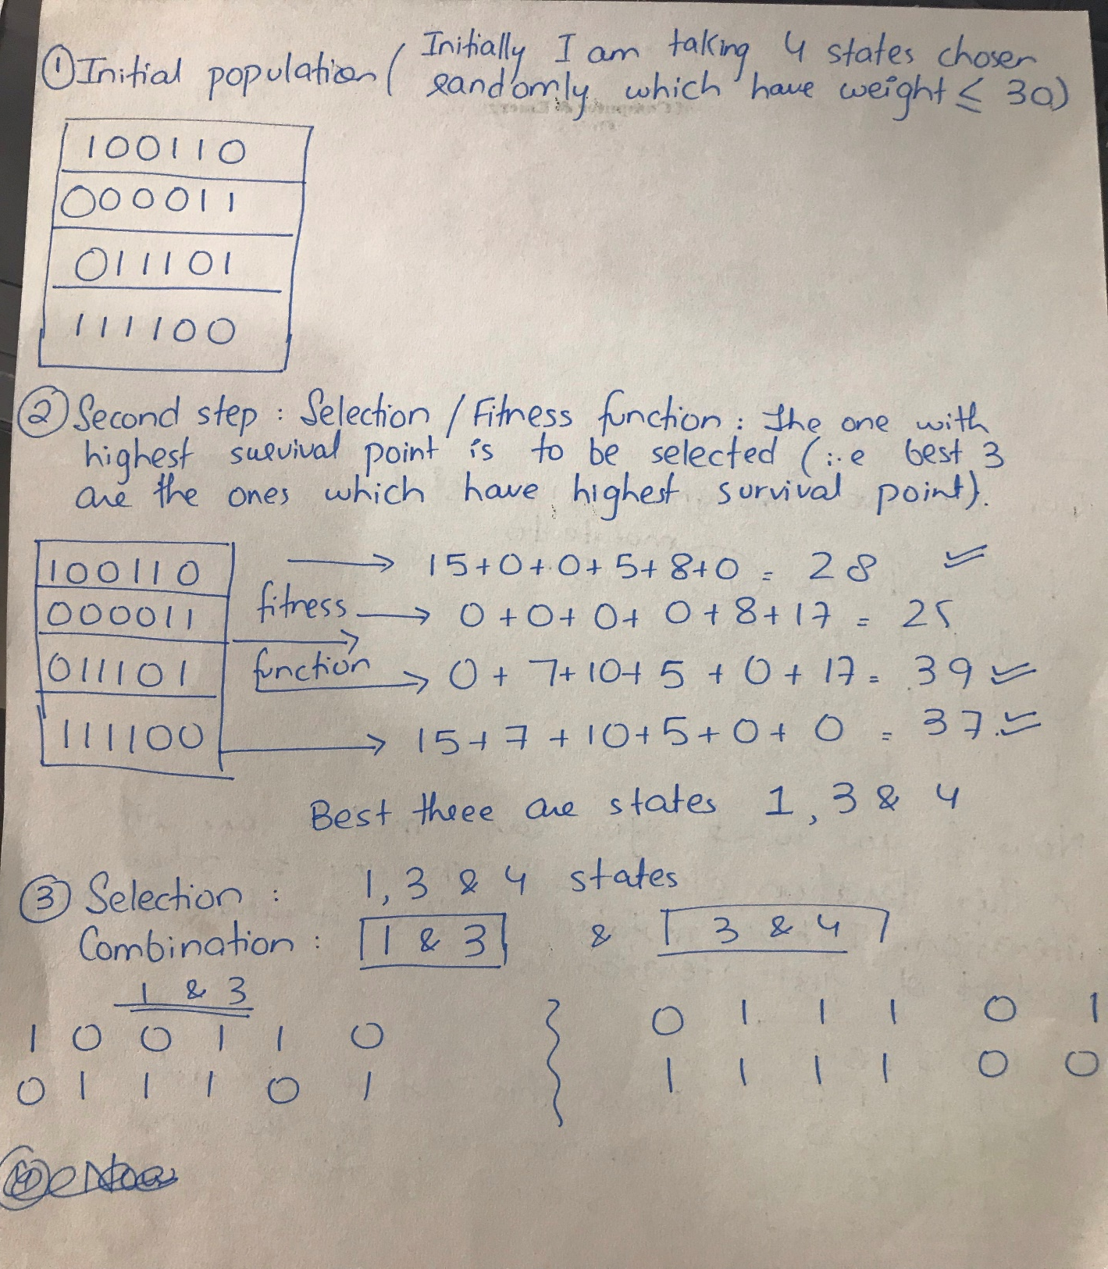

Slide 8
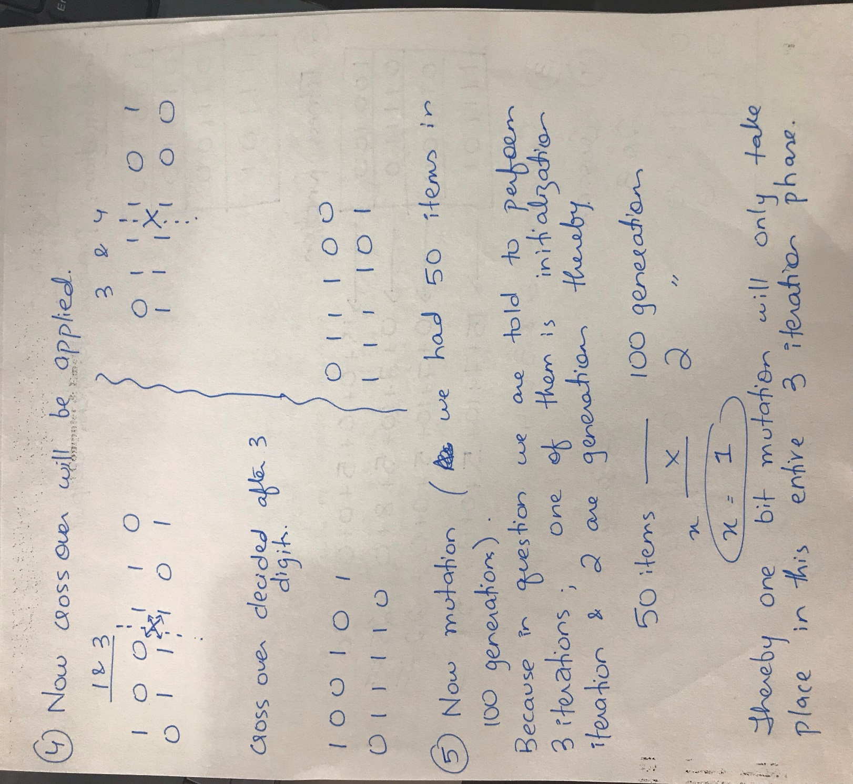

Slide 9
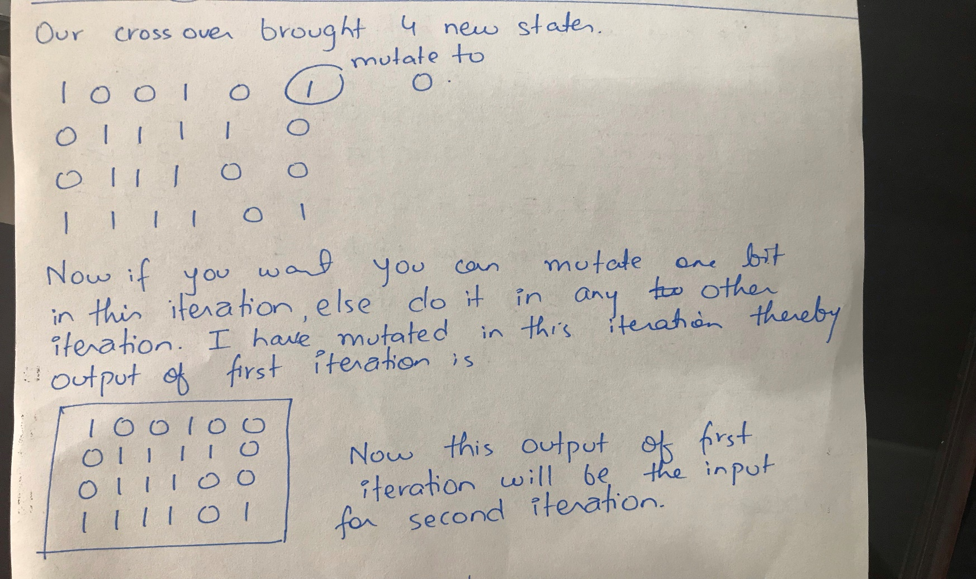

Slide 10
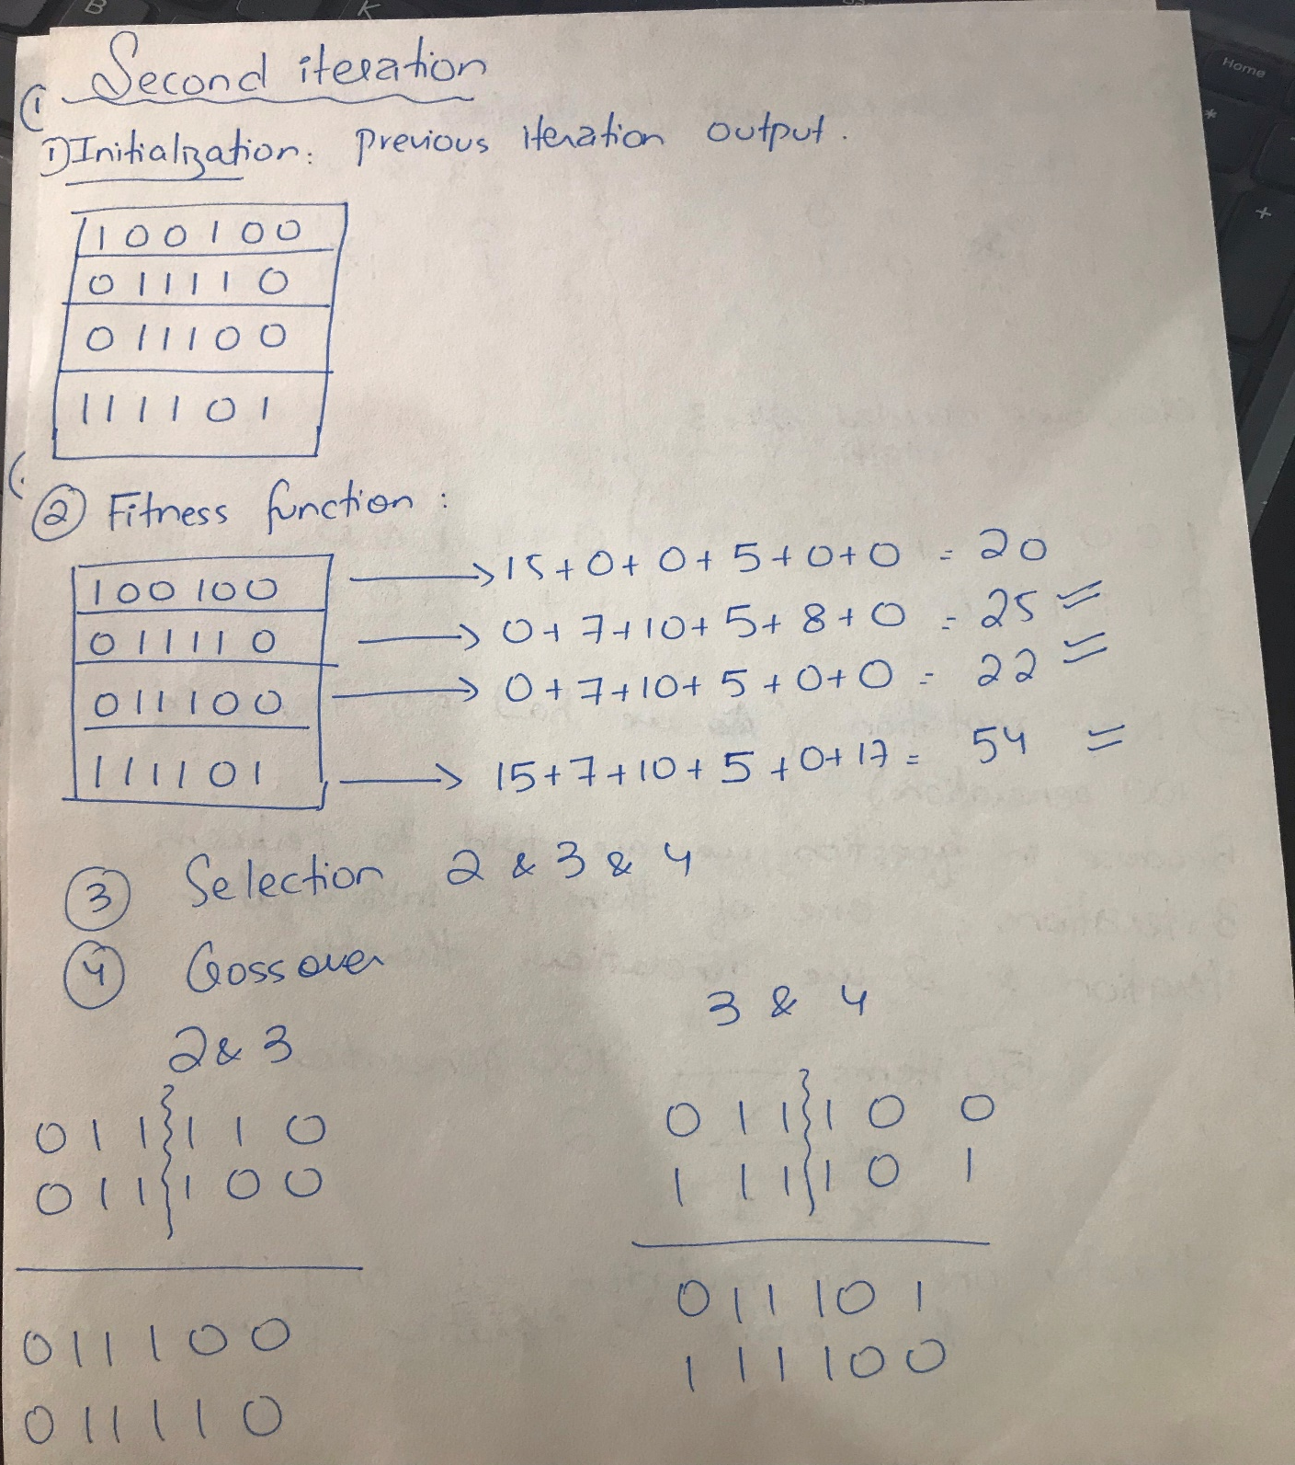

Slide 11
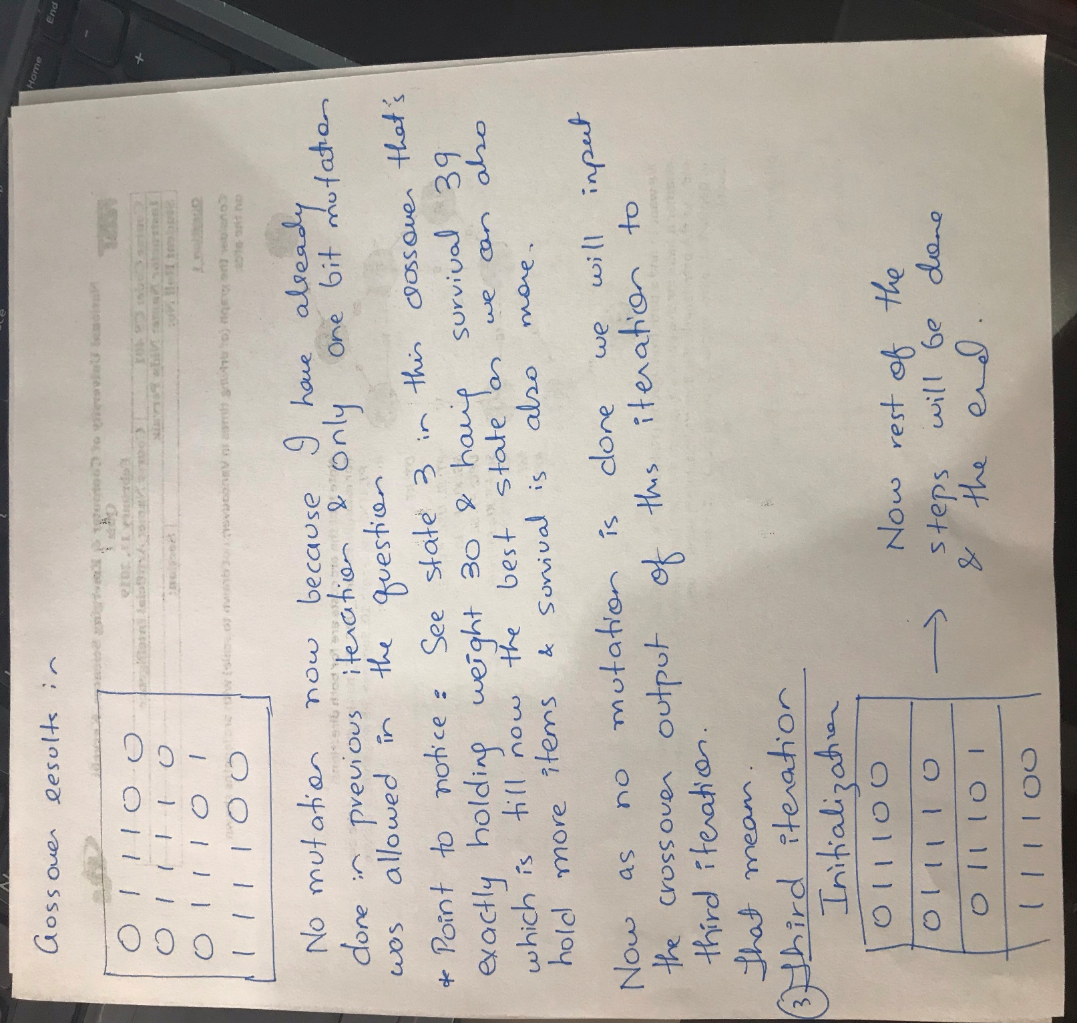
You can do the third iteration on your own now. First two iterations have been done by me.

